Slide 1
Social Networking
Chapter 9
Ethics in Information Technology, Fourth Edition

Slide 2
Objectives
As you read this chapter, consider the following questions:
  What are social networks, how do people use them, and what are some of their practical business uses?
  What are some of the key ethical issues associated with the use of social networking Web sites?
  What is a virtual life community, and what are some of the ethical issues associated with such a community?

Slide 3
What Is a Social Networking Web Site?
Creates an online community of Internet users that eliminates barriers created by time, distance, and cultural differences
Allows people to interact with others online by sharing opinions, insights, information, interests, and experiences

Slide 4
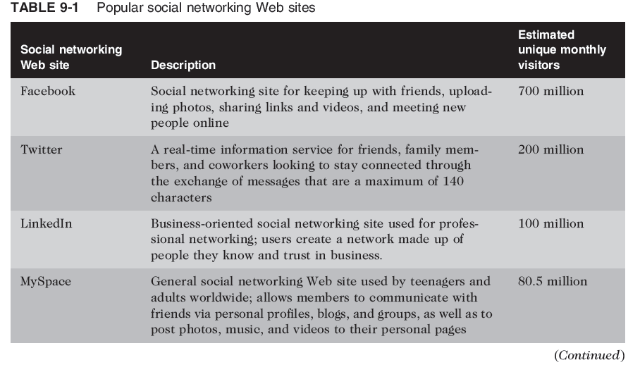

Slide 5
What Is a Social Networking Web Site?
Members may use the site to interact with friends, family members, and colleagues they already know
Members may also wish to develop new personal and professional relationships
Endless range of interests and a wide range of social networking Web sites catering to those interests

Slide 6
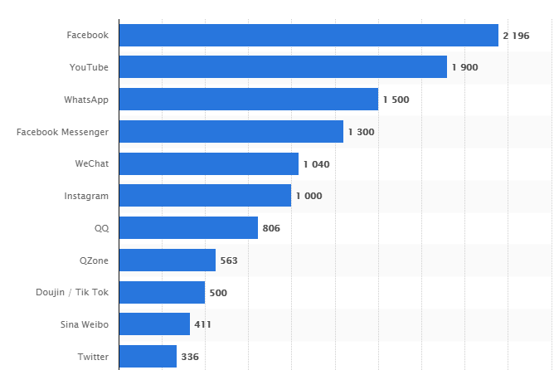
Most famous social network sites worldwide as of July 2018, ranked by number of active users (in millions)

Slide 7
B U S I N E S S A P P L I C A T I ONS O F O N L I N E
S O C I A L N E T W O R K I N G
Notes:
While social networking Web sites are primarily used for nonbusiness purposes, a number
of forward-thinking organizations are employing this technology to advertise, assess job
candidates, and sell products.

Slide 8
1. Social Network Advertising
Uses social networks to communicate and promote the benefits of products and services

Slide 9
1. Social Network Advertising
Two significant advantages of social networking advertising over more traditional advertising media
(e.g., radio, TV, and newspapers) are:
  advertisers can create an opportunity to generate a conversation with viewers of the ad
  ads can be targeted to reach people with the desired demographic characteristics

Slide 10
1. Social Network Advertising
Social network advertising strategies
  Direct advertising
    Banner ads on social networking Web site
    Example:
      an ad for a new magazine on mountain biking could be directed to individuals on a social networking Web site who are male, who are 18 to 35 years old, and who express an interest in mountain biking.
      Others on the social networking Web site would not see it.
Notes:
An ad can
either be displayed to each visitor to the Web site or, by using the information in user
profiles, be directed toward those members who would likely find the product most
appealing.

Slide 11
1. Social Network Advertising
Social network advertising strategies
  Advertising using an individual’s network of friends
    People frequently make decisions based on input from their close group of friends
    Ethical issues with exploiting an individual’s personal relationships for the financial benefit of a company
    Example:
    A message saying, “Jared [your friend] just went to see Transformers II—awesome, he says!”
Notes:
This
might be a spontaneous message sent by Jared, or Jared might be getting paid by an online
promotion firm to send messages about certain products.

Slide 12
1. Social Network Advertising
Social network advertising strategies
  Indirect advertising through groups
    Interested users can join by becoming “fans”
    Effective marketing tool for a company looking to market contests, promote new products, or simply increase brand awareness.
    Fans gained in this manner may not remain loyal

Slide 13
1. Social Network Advertising
Social network advertising strategies
  Indirect advertising through groups
    In August 2008, two fans of Coke, neither of whom had any official connection to the company, launched a Coca-Cola Facebook page. Within a few weeks, the page had attracted over 750,000 fans. As the number of fans grew into the millions, the page’s creators agreed to turn over administration of the page to Coca-Cola.

Slide 14
1. Social Network Advertising
Social network advertising strategies
  Indirect advertising through groups
    The site is monitored by software filters for offensive words and phrases, and live moderators check its pages for anything truly offensive.
    Other than that, Coca-Cola managers pretty much let Facebook fans say what they want on the site.
    The result has been nothing short of amazing. The Facebook fan page quickly grew to over 3 million members worldwide..

Slide 15
1. Social Network Advertising
Social network advertising strategies
  Company-owned social networking Web site
    Users can talk about what new products, services, or improvements they would like to see
    Dell created its own social networking Web site, IdeaStorm, as a means for its millions of customers.

Slide 16
1. Social Network Advertising
Social network advertising strategies
  Viral marketing
    Users pass along marketing message to others, creating the potential for exponential growth
    goal of a viral marketing campaign is to create a buzz about a product or idea
    Example:
      Every e-mail sent by a Hotmail user contained a short message at the end of the e-mail that promoted Hotmail’s free e-mail service.
      As a result, almost 12 million new users signed up for Hotmail over a period of 18 months

Slide 17
2. Social Networks in the Hiring Process
89% of recruiters use some form of social media in the recruiting process
Employers can and do look at the social networking profiles of job candidates when hiring
Companies may reject candidates who post:
  Information about their drinking or drug use
  Provocative or inappropriate photos
  Discriminatory remarks relating to race, gender, or religion
  Confidential information of previous employer

Slide 18
2. Social Networks in the Hiring Process
Employer cannot legally screen applicants based on race or ethnicity, but:
  Members of social networking Web sites frequently provide sex, age, marital status, sexual orientation, religion, and political affiliation data
  Personal photos may reveal a disability or user’s race or ethnicity
Resource executives feel that they can use social networking Web sites to “learn a little about the candidate’s cultural fit and professionalism.”

Slide 19
2. Social Networks in the Hiring Process
BENEFITS
Costs and time to hire are greatly reduced because the audience can be targeted.
Digital applications are available at any time.
Companies have an opportunity to market their brand both on social media platforms, and on the application portal.
The strategy can be adapted along the way. The beauty of social media is that nothing is set in stone.
It is easier to measure and track the sources that applicants are using most.

Slide 20
3. Social Shopping Web Sites
Combine two highly popular online activities:
  shopping and social networking
Brings shoppers and sellers together in a social networking environment in which members can share information and make recommendations while shopping online.
The social shopping Web site Stuffpit has implemented a reward system for members, in which they are paid a commission each time another shopper acts on their recommendation to purchase a specific item.

Slide 21
3. Social Shopping Web Sites
Revenue is generated through retailer advertising or by sharing with retailers data about their members’ likes and dislikes
Retailers can design product improvements based on input and get ideas for new product lines

Slide 22
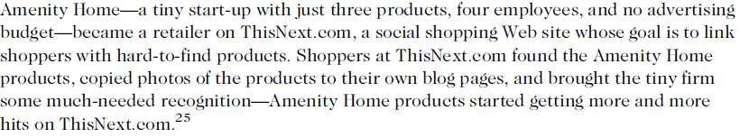
3. Social Shopping Web Sites
Great way for small businesses to boost sales

Slide 23
4. Use of Social Media to Improve Customer Service
Consumers use social networks to share their experiences, both good and bad, with others
Also seek help and advice on how to use products more effectively and how to deal with special situations
Unless organizations monitor social networks, customers are left to resolve questions and issues on their own, risking loss of customers and future sales

Slide 24
Social Networking Ethical Issues
When you have a community of tens of millions of users, not everyone is going to be a good “neighbor” and abide by the rules of the community.
Many will stretch or exceed the bounds of generally accepted behavior

Slide 25
Social Networking Ethical Issues
Ethical issues for social networking Web sites are:
  Cyberbullying
  Cyberstalking
  Sexual predators
  Uploading inappropriate material

Slide 26
1. Cyber Bullying
Cyberbullying
  Harassment, torment, humiliation, or threatening of one minor by another minor or group of minors via the Internet or cell phone
  More common in teenage females and children of age 13-17

Slide 27
1. Cyber Bullying
Cyberbullying can become so intense, child commits suicide
  Ryan Halligan, a 13-year-old boy in Vermont, committed suicide after bullying from his schoolmates and cyberbullying online.
  Megan Meier, a 13-year-old girl from Missouri, also committed suicide when she was harassed by a fictitious boy created by neighbors with whom she had had a falling out
States enacted laws to curb cyberbullying by calling on school districts to develop policies regarding cyberbullying detection and punishment

Slide 28
1. Cyber Bullying
Numerous forms of cyberbullying
  Sending mean-spirited or threatening messages
  Sending thousands of text messages to victim’s cell phone and running up a huge cell phone bill
  Impersonating victim and sending inappropriate messages to others
  Stealing victim’s password and modifying his or her profile to include racist, homophobic, sexual, or other inappropriate data that offends others or attracts the attention of undesirable people

Slide 29
1. Cyber Bullying
Numerous forms of cyberbullying (cont’d.)
  Posting mean, personal, or false information about the victim in the cyberbully’s blog
  Creating a Web site whose purpose is to humiliate or threaten the victim
  Taking inappropriate photos of the victim and either posting online or sending to others via cell phone
  Setting up an Internet poll to elicit responses to embarrassing questions regarding victim
  Sending inappropriate messages while playing interactive games

Slide 30
1. Cyber Bullying
Can be reduced if we do counselling of our children.
Because minors do not report cyberbullying to their parents.

Slide 31
2. Cyber Stalking
Cyberstalking
  Threatening behavior or unwanted advances using the Internet or online and electronic communications
  Adult version of cyberbullying
  Can escalate into:
    Abusive or excessive phone calls
    Threatening or obscene mail
    Trespassing
    Vandalism
    Physical stalking
    Physical assault

Slide 32
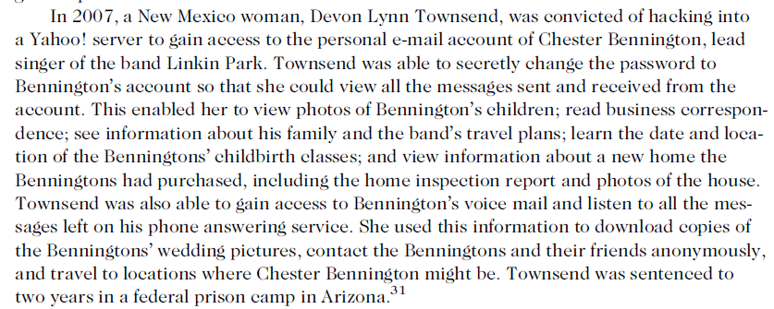
2. Cyber Stalking

Slide 33
2. Cyber Stalking
A set of recommended actions for combating cyberstalking:
  When the offender is known, victims should send the stalker a written notice that their contact is unwanted and that all further contact must cease.
  Evidence of all contacts should be saved.
  Victims of cyberstalking should inform their ISP provider
  Victims should consider speaking to law enforcement officers.
  victims of cyberstalking should never agree to meet with the stalker to “talk things out.”

Slide 34
3. Encounters with sexual predators
Encounters with sexual predators
  Some social networking Web sites are criticized for not protecting minors from sexual predators

Slide 35
4. Uploading of inappropriate material
Uploading of inappropriate material
  Social networking Web sites have policies against uploading videos depicting violence or obscenity
  Most social networking Web sites have terms of use agreements that give the sites the right to delete material and terminate users accounts that violate their policy

Slide 36
4. Uploading of inappropriate material
Most Web sites do not have sufficient resources to review all material posted.
  Quite often, it is only after other members of a social networking Web site complain about objectionable material that such material is taken down.
  reviewers would also look at the text content submitted to a networking site

Slide 37
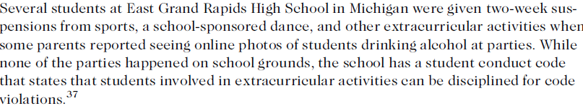
4. Uploading of inappropriate material

Slide 38
Online Virtual Worlds
Virtual world is a shared multimedia, computer-generated environment in which users represented by avatars can act, communicate, create, retain ownership of what they create, and exchange assets with each other
Virtual worlds are usually thought of as alternative worlds where visitors go to entertain themselves and interact with others.

Slide 39

Online Virtual Worlds (cont’d.)
A visitor to a virtual world represents him
or herself through an avatar
Avatars can do everything one can do
in real life
  Shop, hold jobs, run for political office
  Develop relationships with other avatars
  Start up new businesses
  Engage in criminal activities
Avatars use the virtual world’s currency to
purchase goods and services in the virtual world.

Slide 40
Online Virtual Worlds (cont’d.)
Avatars use the virtual world’s currency to
purchase goods and services in the virtual world.
or their owners can purchase virtual
world money for them using real world cash.

Slide 41
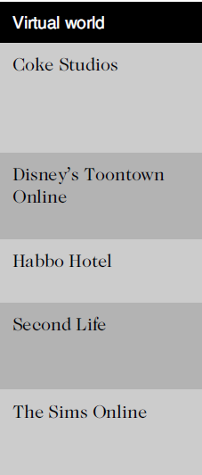
Online Virtual Worlds (cont’d.)

Slide 42

SIMS

Slide 43
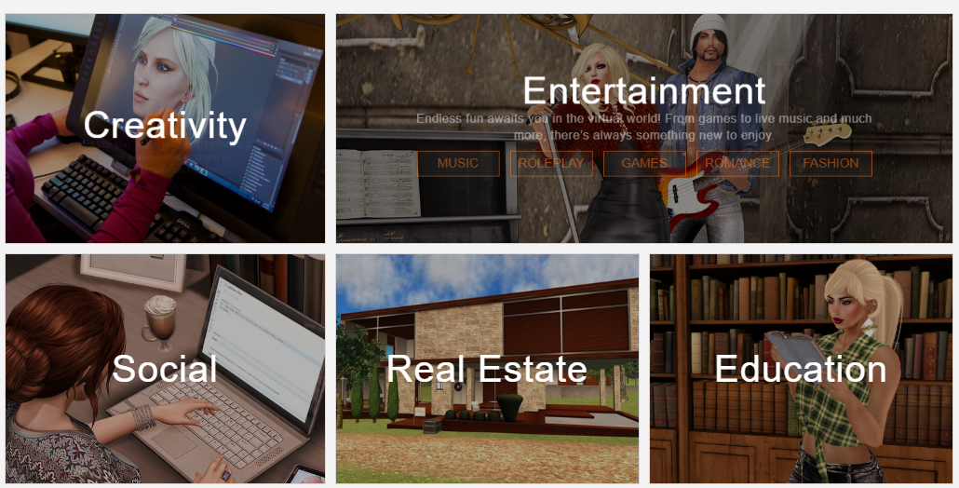

Slide 44
Crime in Virtual Worlds
Should law enforcement—real or virtual—get involved in acts that occur in virtual worlds?
Criminal acts in a virtual world:
  Can be clearly illegal, such as trafficking in actual drugs or stolen credit cards
  May not be real-life crime, such as virtual muggings and sex crimes that can cause real life anguish
  May be in the gray area, for example, unfair operation of virtual casinos

Slide 45

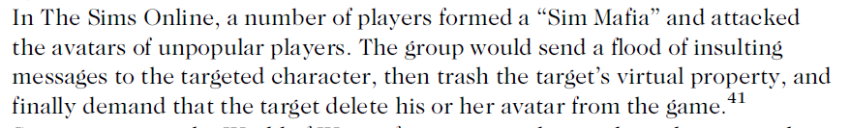
Crime in Virtual Worlds

Slide 46

Crime in Virtual Worlds

Slide 47
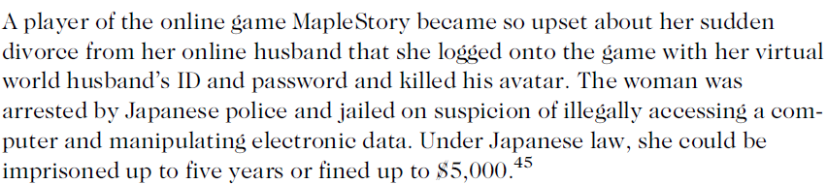
Crime in Virtual Worlds

Slide 48
Educational and Business Uses of Virtual Worlds
New Media Consortium (NMC)
  International consortium of hundreds of organizations
  Explores new media and technologies to improve teaching, learning, and creative expression
  Also builds custom virtual learning worlds, simulations, and learning games

Slide 49
Educational and Business Uses of Virtual Worlds

Slide 50
Educational and Business Uses of Virtual Worlds
Second Life Work
  Enable businesses and government agencies to use Second Life for virtual meetings, events, training, and simulations

Slide 51
What Would you do ??
You have just received a second invitation to join Jane’s friend list. You met Jane three weeks ago at a group study session prior to last semester’s Calculus II finals. She came across as very quiet and sort of strange. You did nothing to encourage her attention, but now you keep running into her at the oddest places and oddest times—at the self-service car wash, the 24-hour gym at 1:00 a.m., and the bakery at 7:00 a.m. She always flashes you a smile but has nothing to say. You think you’ve caught her taking snapshots of you a couple of times with his cell phone. She is starting to creep you out.

